Slide 1
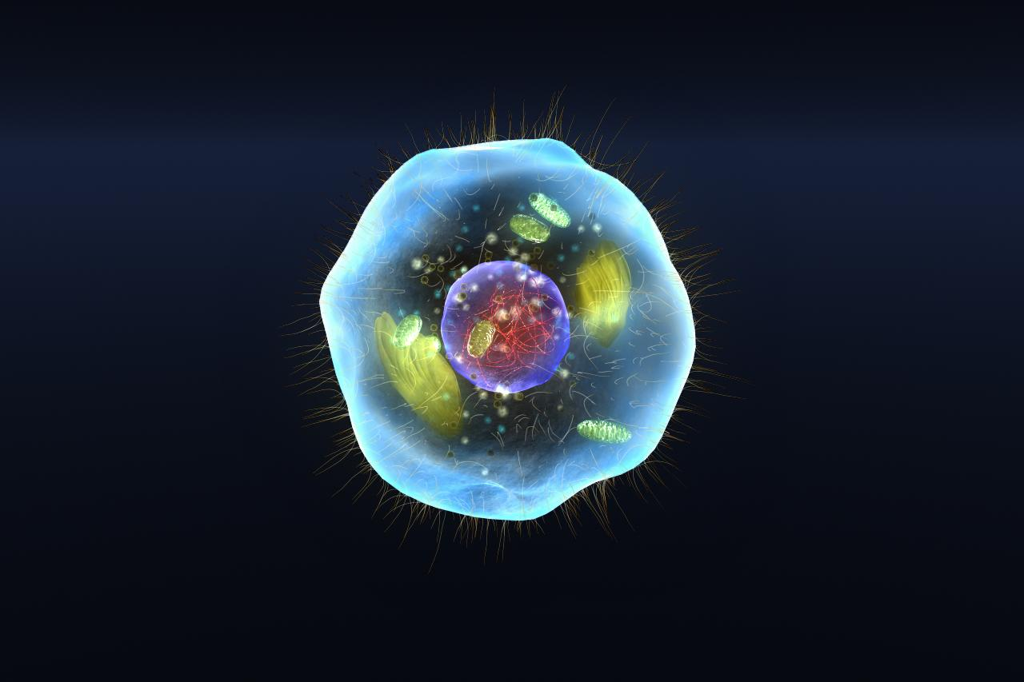
Cell Structures

Slide 2
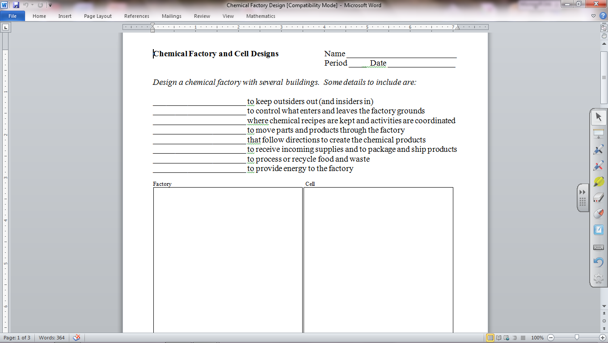

Slide 3
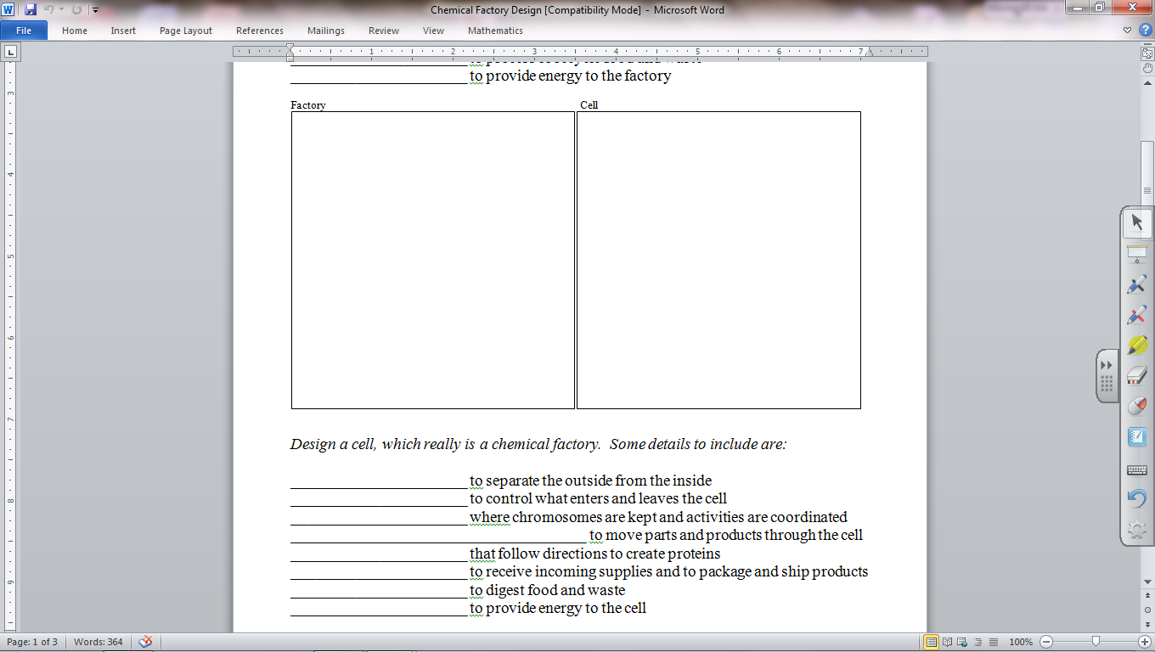

Slide 5
Oxen VS Wolves(1).mp4

Slide 6
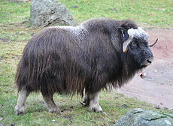

Slide 7
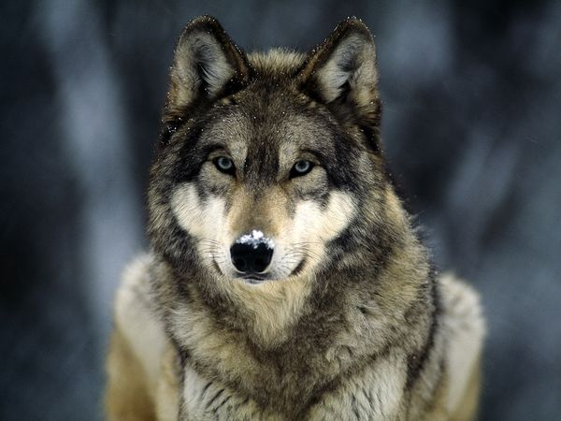

Slide 20
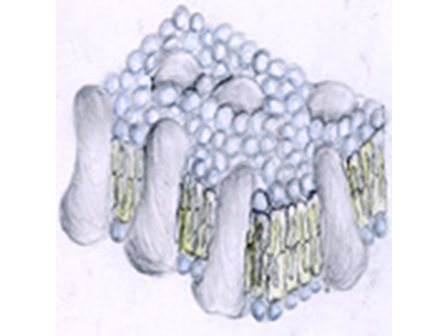

Slide 21
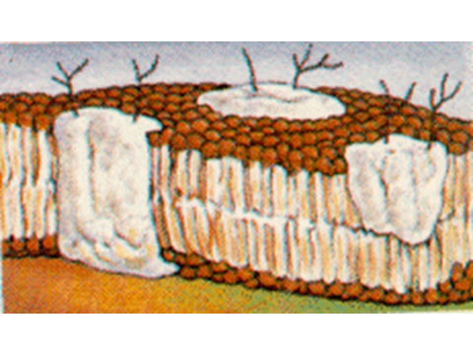

Slide 22
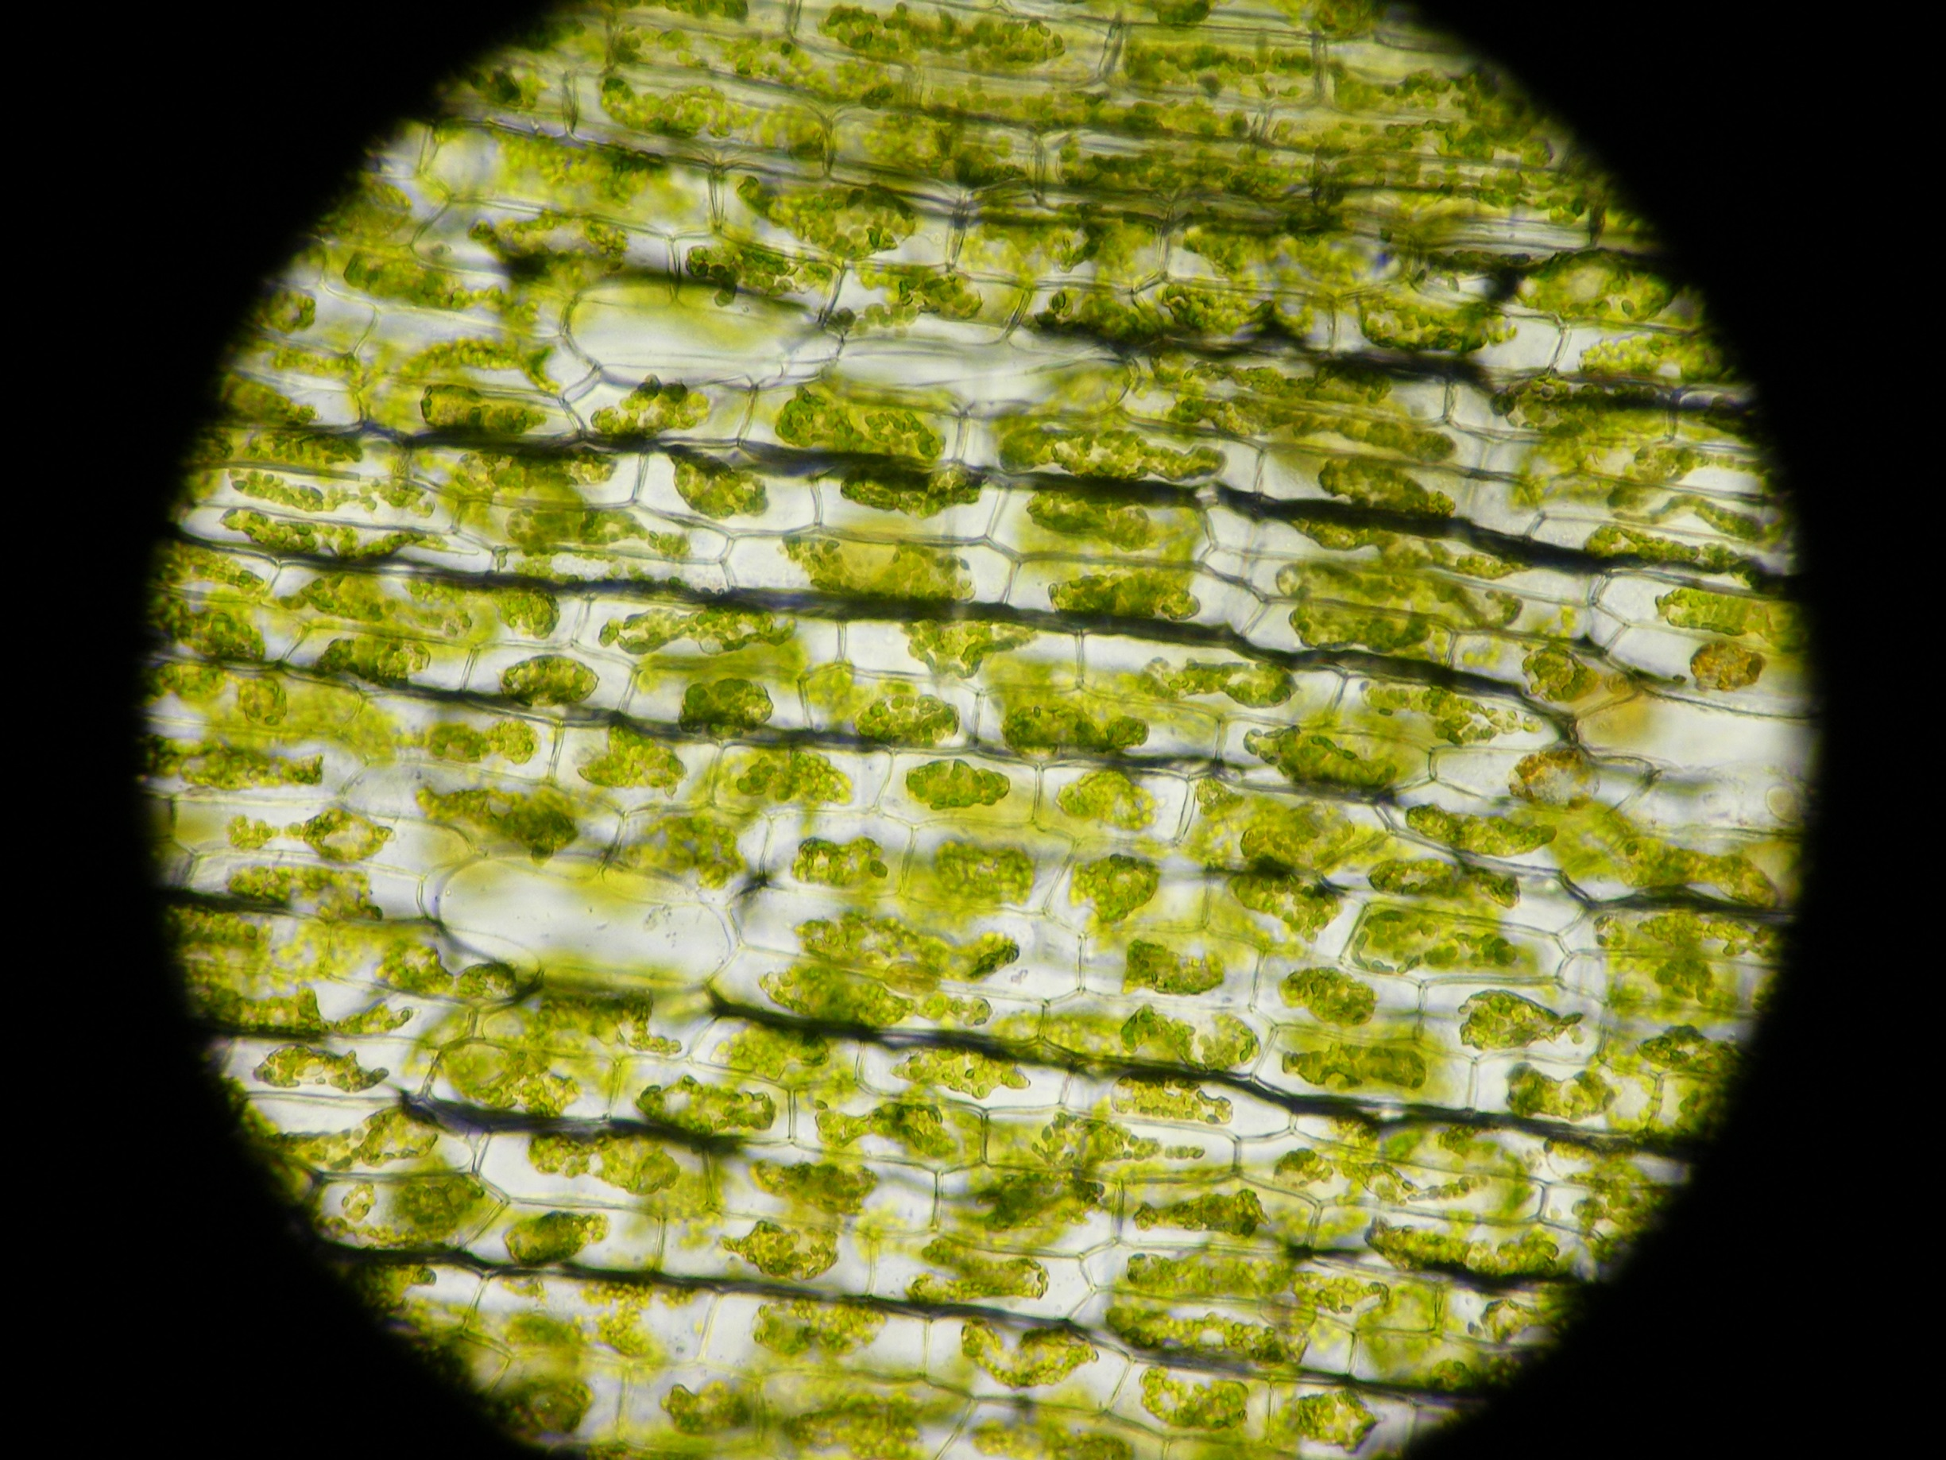
Cell Types

Slide 24
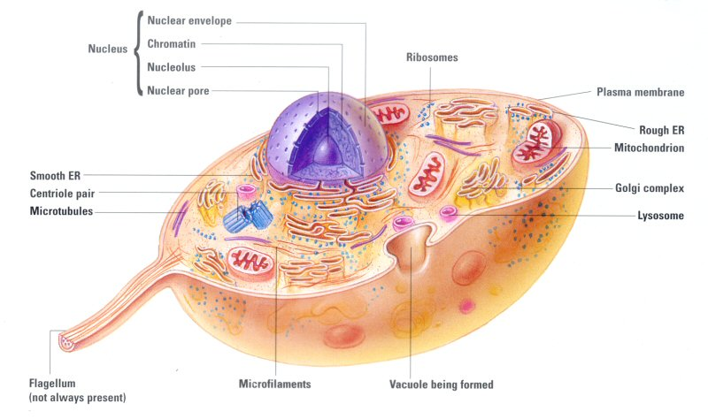

Slide 26
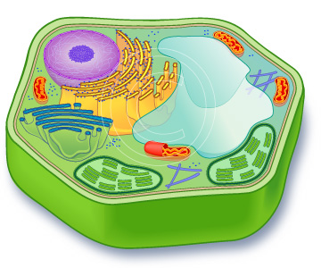

Slide 28
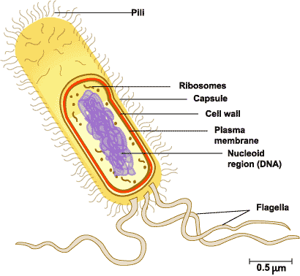

Slide 29
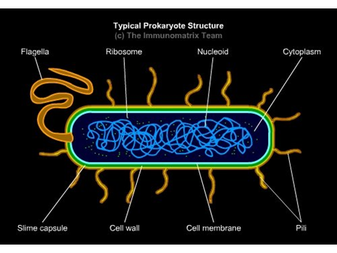

Slide 30
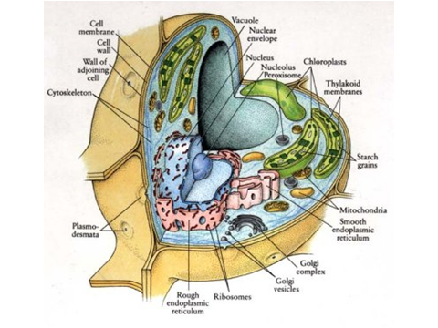

Slide 31
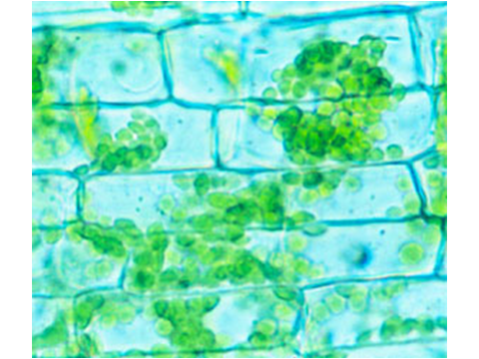

Slide 32
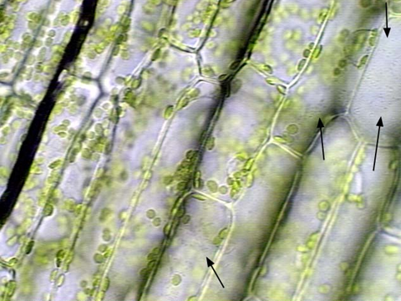

Slide 33
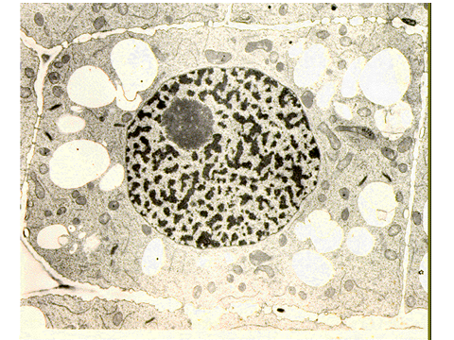

Slide 34
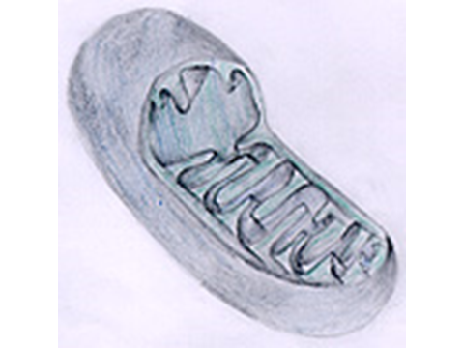

Slide 35
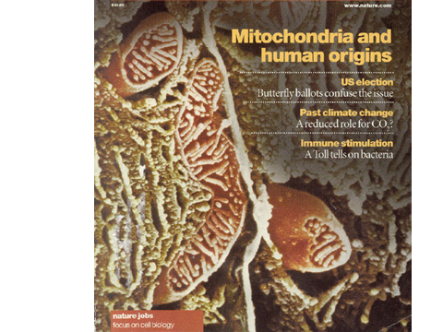

Slide 36
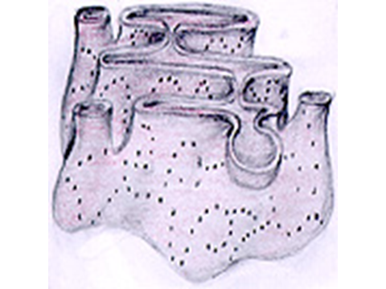

Slide 37
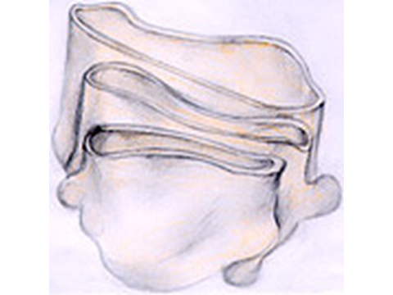

Slide 38
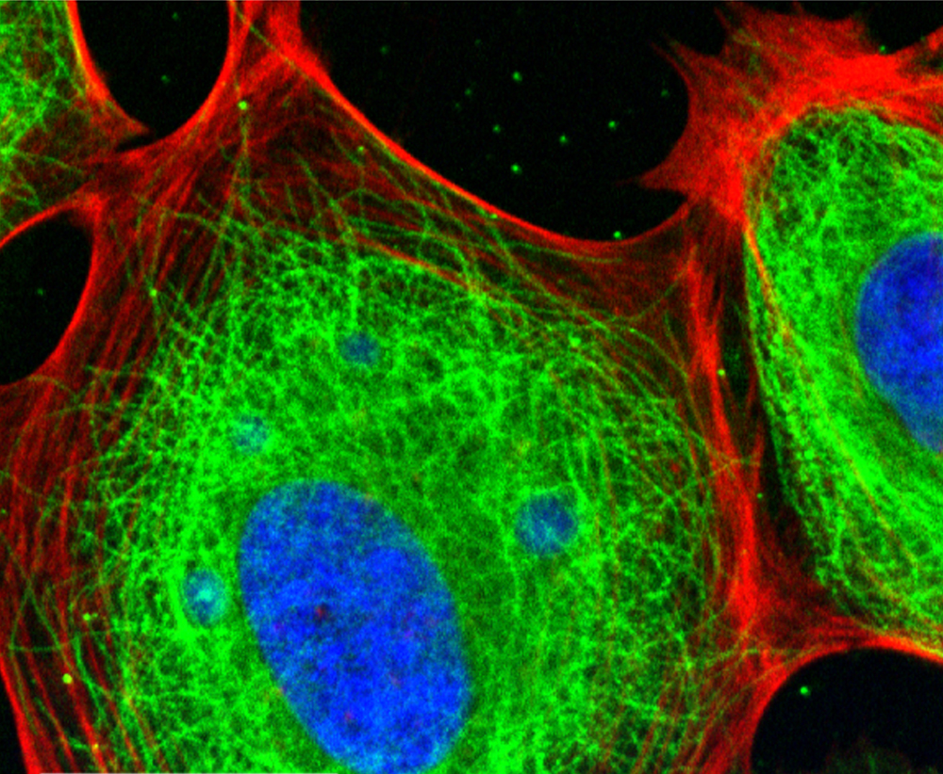
Cytoskeleton

Slide 39
The cytoskeleton (cell skeleton) maintains the structure of animal cells and helps cells move. There are two types:
Microtubules
Microfilaments

Slide 40
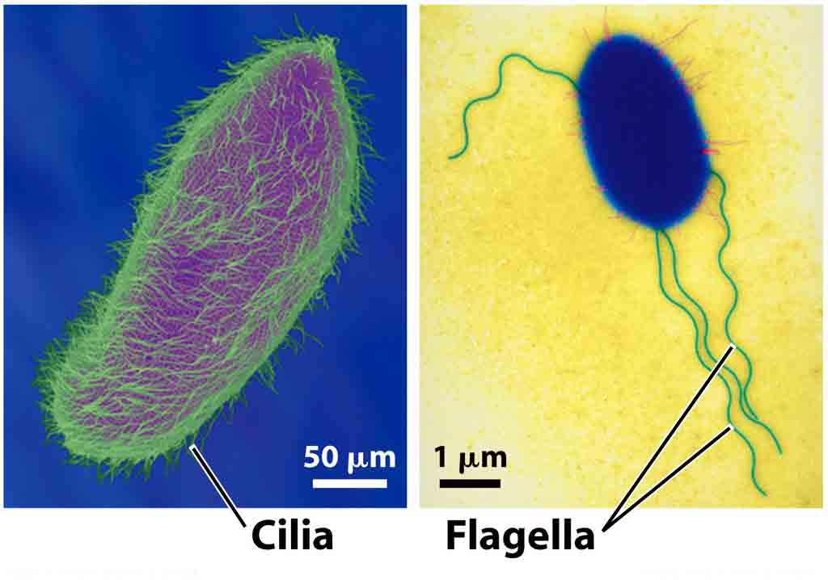
Cytoskeleton
Microtubules are hollow tubes that act like scaffolding to maintaining a cell's shape and provide a path for organelle movement.
Bundles of microtubules create
structures useful for movement:
cilia (short, hairlike)
flagella (long, whiplike)

Slide 41
Cytoskeleton
Microfilaments are like a rope of two twisted protein chains. Microfilaments can contract, causing movement. The contraction of muscle is due to the action of microfilaments.

Slide 42
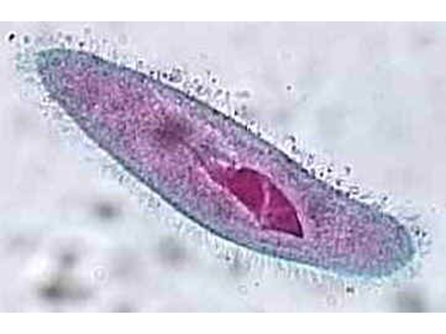

Slide 43
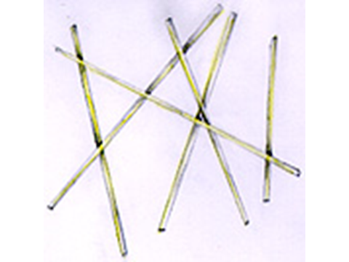

Slide 44
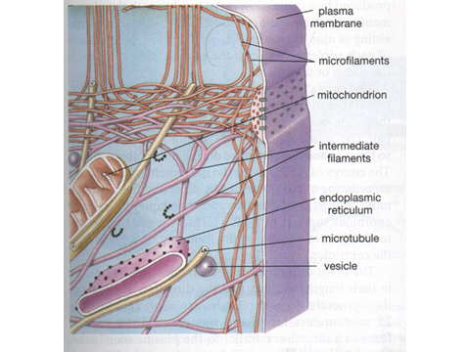

Slide 45
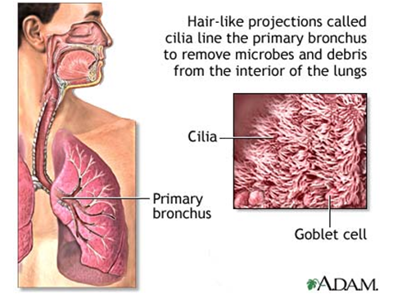

Slide 46
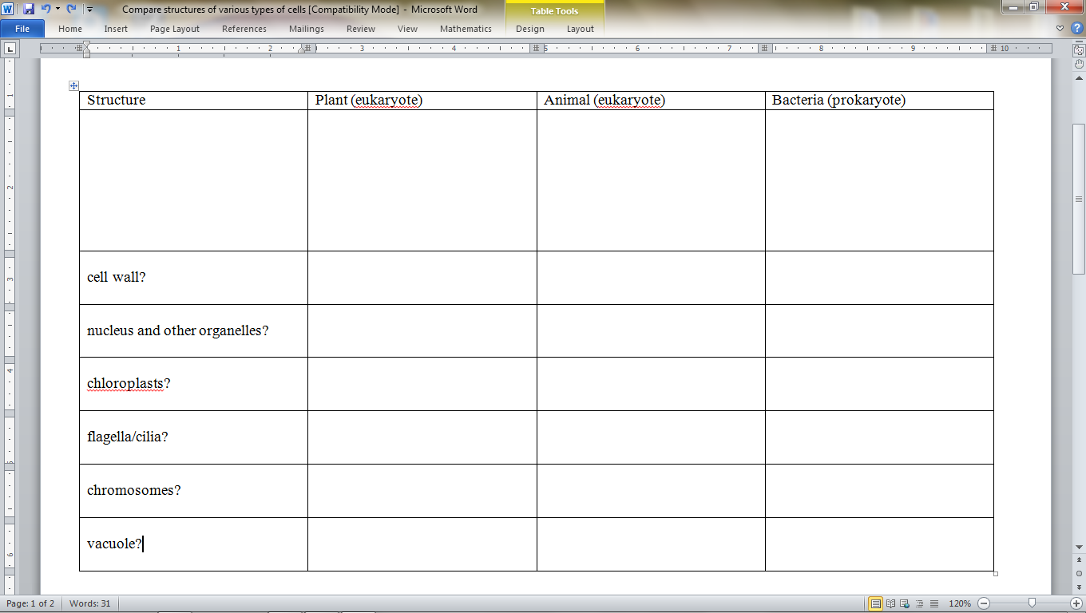

Slide 48
Prokaryote
Eukaryote
Eukaryote
Examples:
Can it have?:
Cell membrane?
Cell wall?
Nucleus?
Chloroplast?
Chromosome?
Flagella?

Slide 49
YouTube Links
The Cell Song (1).mp4
A Tour of the Cell.mp4
Cell Types.mp4
All You Need To Know About Stem Cells.mp4
7A - Cells - Bill Nye the Science Guy.mp4

Slide 51
Attachments
Oxen VS Wolves(1).mp4
The Cell Song (1).mp4
All You Need To Know About Stem Cells.mp4
A Tour of the Cell.mp4
Cell Types.mp4
7A - Cells - Bill Nye the Science Guy.mp4

